Slide 1

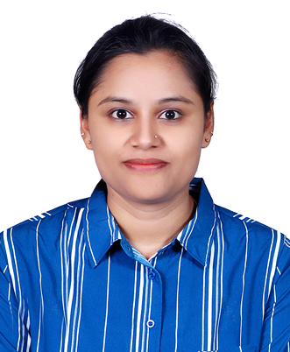
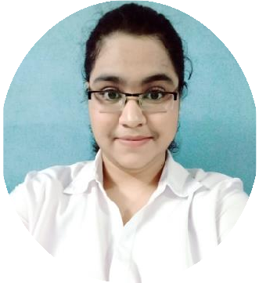




Poojarani Chandrakant Gurav
Education and certificates Bachelor of Engineering Information Technology: 2019
Skills
Analyst/Software Engineer
Base Location: Mumbai
Email ID: POOJARANI.GURAV@CAPGEMINI.COM
Mobile No: +91 9096292581
Grade: A4
C# | Basics, OOPS, Exception Handling, Collections & Generics, Delegates , Events , File IO and Serialization
.NET Framework | Architecture which includes CTS,CLS , FCL , BCL and CLR
ADO.NET | Basics, Connected and Disconnected Architecture
Software Testing | Manual Testing and Automation Testing using JAVA
RDBMS | Basic And Advanced Using SQL Server
Python | Basics, OOPS, File Handling, Modules like NumPy, Pandas, Matplotlib, Web Scraping
Machine Learning | Basics like Classification, Regression, SVM of ML, Algorithms used
UI Technology | HTML 5, CSS
Add On Skills | Communication , Team management
Strengths
Achievement
Full Stack Developer
Practical understanding of RDBMS concepts using SQL Server.
Completed case study on CropDeal which is used to solve the problem of Farmers who struggle and facing to sell their crops in the market for proper price and many more problems such as cost of transportation, wait time, negotiations for proper price, paying lot of intermittent charges as commissions, etc.
Completed Certification in Python Programming and Machine Learning.
Completed Certification in AZ-900, AZ-104, AZ-204.
Hands on experience in developing applications using
C#, .NET Framework, ADO.NET, Asp.NET core and SQL Server.
Understanding of Git and GitHub.
Understanding of HTML5, CSS, Javascript, Typescript and Angular.
Recently Completed training on iTransform-Microsoft .NET Core and Azure Fundamentals.
Work experience as a Python Developer.
https://github.com/PoojaGurav
Presentation Title | Author | Date © Capgemini 2017. All rights reserved | 1

